Slide 1
Validate Usability testing findings

Slide 2
Search criteria
Validate - Usability testing
Search page, Keywords
Users find that the Search Page is nice and simple, they understand what is expected of them from the search page from the Titles and labels
Users are unsure of how to use the keywords, phone number fields.
Add instruction on how to use keywords and phone numbers
Notes:
This is our Digital team UX Process Model, and it shows how Design should follow an iterative cycle. These steps would be repeated for each segment or feature of a product to test and validate new functionality throughout the design and build phases.
We start off with the Discover phase, which helps us understand the initial requirements and is the first opportunity for us to validate any assumptions on what our user needs are. We would review existing research that has been performed, or do some desk research or competitor analysis, as well as get familiar with the business requirements.
Next would be the Define phase, which is where the majority of UX assets would be created such as ‘as is’ and ‘to be’ journey mappings, we would start mapping out high level screenflows and taskflow mappings, and towards the latter end of this phase we would start creating the prototype or screen designs.
In the Develop phase we would test and validate the proposed solution, so this could be testing an initial design concept with users to gather feedback, or it could be later on in a project where the built product is being tested and validated before going live.
The Deliver phase is where we present back any research data collected in the validate phase, and would also be where UX roadmap items are prioritised, or analytics and feedback data is reviewed from customer surveys or any other data collected.

Slide 3
Search criteria
Validate - Usability testing
Date of Birth, Age, Age range
Dob, Age, age range. Knew how to use because of exposure to similar design in other system or because of trial and error
Add instructions to show how to use Dob Age Age Range fields.
Bug When no age is entered, the drop down is clickable but empty. User assumed that system was not working.
Disable drop down when age is empty
Notes:
This is our Digital team UX Process Model, and it shows how Design should follow an iterative cycle. These steps would be repeated for each segment or feature of a product to test and validate new functionality throughout the design and build phases.
We start off with the Discover phase, which helps us understand the initial requirements and is the first opportunity for us to validate any assumptions on what our user needs are. We would review existing research that has been performed, or do some desk research or competitor analysis, as well as get familiar with the business requirements.
Next would be the Define phase, which is where the majority of UX assets would be created such as ‘as is’ and ‘to be’ journey mappings, we would start mapping out high level screenflows and taskflow mappings, and towards the latter end of this phase we would start creating the prototype or screen designs.
In the Develop phase we would test and validate the proposed solution, so this could be testing an initial design concept with users to gather feedback, or it could be later on in a project where the built product is being tested and validated before going live.
The Deliver phase is where we present back any research data collected in the validate phase, and would also be where UX roadmap items are prioritised, or analytics and feedback data is reviewed from customer surveys or any other data collected.

Slide 4
Search criteria
Validate - Usability testing
Sources
The source section is difficult to understand for users
The label “Account check” is not understood by the users
Users are unsure about when or if they should be clicking the buttons
Unsure about what clicking the sources buttons will do
Someone asked for a default selection. An other person mentioned that on an other system the sources are selected as you type when they are available
Add instructions and explanations to guide users and remove confusion.
Work on making the source selection more interactive
MNTR-7503
Notes:
This is our Digital team UX Process Model, and it shows how Design should follow an iterative cycle. These steps would be repeated for each segment or feature of a product to test and validate new functionality throughout the design and build phases.
We start off with the Discover phase, which helps us understand the initial requirements and is the first opportunity for us to validate any assumptions on what our user needs are. We would review existing research that has been performed, or do some desk research or competitor analysis, as well as get familiar with the business requirements.
Next would be the Define phase, which is where the majority of UX assets would be created such as ‘as is’ and ‘to be’ journey mappings, we would start mapping out high level screenflows and taskflow mappings, and towards the latter end of this phase we would start creating the prototype or screen designs.
In the Develop phase we would test and validate the proposed solution, so this could be testing an initial design concept with users to gather feedback, or it could be later on in a project where the built product is being tested and validated before going live.
The Deliver phase is where we present back any research data collected in the validate phase, and would also be where UX roadmap items are prioritised, or analytics and feedback data is reviewed from customer surveys or any other data collected.

Slide 5
Results summary page
Validate - Usability testing
Edit search and matching results
Solution is being implemented.
They cannot Modify their search criteria, that is causing a lot of frustration to the users
Users struggled to understand why a result was a match at a glance.
Highlight top matches and indicate why other results are included
Notes:
This is our Digital team UX Process Model, and it shows how Design should follow an iterative cycle. These steps would be repeated for each segment or feature of a product to test and validate new functionality throughout the design and build phases.
We start off with the Discover phase, which helps us understand the initial requirements and is the first opportunity for us to validate any assumptions on what our user needs are. We would review existing research that has been performed, or do some desk research or competitor analysis, as well as get familiar with the business requirements.
Next would be the Define phase, which is where the majority of UX assets would be created such as ‘as is’ and ‘to be’ journey mappings, we would start mapping out high level screenflows and taskflow mappings, and towards the latter end of this phase we would start creating the prototype or screen designs.
In the Develop phase we would test and validate the proposed solution, so this could be testing an initial design concept with users to gather feedback, or it could be later on in a project where the built product is being tested and validated before going live.
The Deliver phase is where we present back any research data collected in the validate phase, and would also be where UX roadmap items are prioritised, or analytics and feedback data is reviewed from customer surveys or any other data collected.

Slide 6
Results summary page
Validate - Usability testing
Add more interaction and add relevant details
Users want to know how likely this person is to be at the address indicated before they at the detailed info, they can skip it if they don’t live at the location anymore
Show if they are goneway on summary page
From this page, they want to click on an address, phone number, email and if this is linked to other people.
Make phone number, address and emails clickable
Notes:
This is our Digital team UX Process Model, and it shows how Design should follow an iterative cycle. These steps would be repeated for each segment or feature of a product to test and validate new functionality throughout the design and build phases.
We start off with the Discover phase, which helps us understand the initial requirements and is the first opportunity for us to validate any assumptions on what our user needs are. We would review existing research that has been performed, or do some desk research or competitor analysis, as well as get familiar with the business requirements.
Next would be the Define phase, which is where the majority of UX assets would be created such as ‘as is’ and ‘to be’ journey mappings, we would start mapping out high level screenflows and taskflow mappings, and towards the latter end of this phase we would start creating the prototype or screen designs.
In the Develop phase we would test and validate the proposed solution, so this could be testing an initial design concept with users to gather feedback, or it could be later on in a project where the built product is being tested and validated before going live.
The Deliver phase is where we present back any research data collected in the validate phase, and would also be where UX roadmap items are prioritised, or analytics and feedback data is reviewed from customer surveys or any other data collected.

Slide 7
Results summary page
Validate - Usability testing
Notes and observations
Bug
The date format doesn’t match the date entered by the user
Visual improvement
Reduce size of date of birth column and expand the address column to make the results easier to scan.
Notes:
This is our Digital team UX Process Model, and it shows how Design should follow an iterative cycle. These steps would be repeated for each segment or feature of a product to test and validate new functionality throughout the design and build phases.
We start off with the Discover phase, which helps us understand the initial requirements and is the first opportunity for us to validate any assumptions on what our user needs are. We would review existing research that has been performed, or do some desk research or competitor analysis, as well as get familiar with the business requirements.
Next would be the Define phase, which is where the majority of UX assets would be created such as ‘as is’ and ‘to be’ journey mappings, we would start mapping out high level screenflows and taskflow mappings, and towards the latter end of this phase we would start creating the prototype or screen designs.
In the Develop phase we would test and validate the proposed solution, so this could be testing an initial design concept with users to gather feedback, or it could be later on in a project where the built product is being tested and validated before going live.
The Deliver phase is where we present back any research data collected in the validate phase, and would also be where UX roadmap items are prioritised, or analytics and feedback data is reviewed from customer surveys or any other data collected.

Slide 8
Results summary page
Validate - Usability testing
Notes and observations
They don’t mind a spread of data, they can search for potential aliases
They prefer to scroll and scan, they barely use other search functionalities. Ctrl+F, to search for partial info
No need to add a search, sort or filter functionality based on this feedback
Not interested or impressed with the export in .csv functionality. One of them would like to export is pdf for future reference.
Results summary page in .pdf format would be a nice to have based on this feedback
Notes:
This is our Digital team UX Process Model, and it shows how Design should follow an iterative cycle. These steps would be repeated for each segment or feature of a product to test and validate new functionality throughout the design and build phases.
We start off with the Discover phase, which helps us understand the initial requirements and is the first opportunity for us to validate any assumptions on what our user needs are. We would review existing research that has been performed, or do some desk research or competitor analysis, as well as get familiar with the business requirements.
Next would be the Define phase, which is where the majority of UX assets would be created such as ‘as is’ and ‘to be’ journey mappings, we would start mapping out high level screenflows and taskflow mappings, and towards the latter end of this phase we would start creating the prototype or screen designs.
In the Develop phase we would test and validate the proposed solution, so this could be testing an initial design concept with users to gather feedback, or it could be later on in a project where the built product is being tested and validated before going live.
The Deliver phase is where we present back any research data collected in the validate phase, and would also be where UX roadmap items are prioritised, or analytics and feedback data is reviewed from customer surveys or any other data collected.

Slide 9
Detailed results page
Validate - Usability testing
Interactivity
Lack of interactivity is a big issue
Going back to the search screen to do a search makes the application clunky and difficult to use.
Example
To investigate a linked person, they must
Click
Drag to highlight
Right click
Copy
Press the back button twice
Then copy and clean the data to put the right value in the right place
Select Validate as a source and press search
Allow the users to click on a relevant item and search further on Validate
Notes:
This is our Digital team UX Process Model, and it shows how Design should follow an iterative cycle. These steps would be repeated for each segment or feature of a product to test and validate new functionality throughout the design and build phases.
We start off with the Discover phase, which helps us understand the initial requirements and is the first opportunity for us to validate any assumptions on what our user needs are. We would review existing research that has been performed, or do some desk research or competitor analysis, as well as get familiar with the business requirements.
Next would be the Define phase, which is where the majority of UX assets would be created such as ‘as is’ and ‘to be’ journey mappings, we would start mapping out high level screenflows and taskflow mappings, and towards the latter end of this phase we would start creating the prototype or screen designs.
In the Develop phase we would test and validate the proposed solution, so this could be testing an initial design concept with users to gather feedback, or it could be later on in a project where the built product is being tested and validated before going live.
The Deliver phase is where we present back any research data collected in the validate phase, and would also be where UX roadmap items are prioritised, or analytics and feedback data is reviewed from customer surveys or any other data collected.

Slide 10
Detailed results page
Validate - Usability testing
Linked people
They want to see more details about the linked people, including how these people are linked to the person they selected.
They want the same detailed view when investigating a linked person
More details are being added see MNTR-7834
Discussion with CCM to understand how link between people is generated
Notes:
This is our Digital team UX Process Model, and it shows how Design should follow an iterative cycle. These steps would be repeated for each segment or feature of a product to test and validate new functionality throughout the design and build phases.
We start off with the Discover phase, which helps us understand the initial requirements and is the first opportunity for us to validate any assumptions on what our user needs are. We would review existing research that has been performed, or do some desk research or competitor analysis, as well as get familiar with the business requirements.
Next would be the Define phase, which is where the majority of UX assets would be created such as ‘as is’ and ‘to be’ journey mappings, we would start mapping out high level screenflows and taskflow mappings, and towards the latter end of this phase we would start creating the prototype or screen designs.
In the Develop phase we would test and validate the proposed solution, so this could be testing an initial design concept with users to gather feedback, or it could be later on in a project where the built product is being tested and validated before going live.
The Deliver phase is where we present back any research data collected in the validate phase, and would also be where UX roadmap items are prioritised, or analytics and feedback data is reviewed from customer surveys or any other data collected.

Slide 11
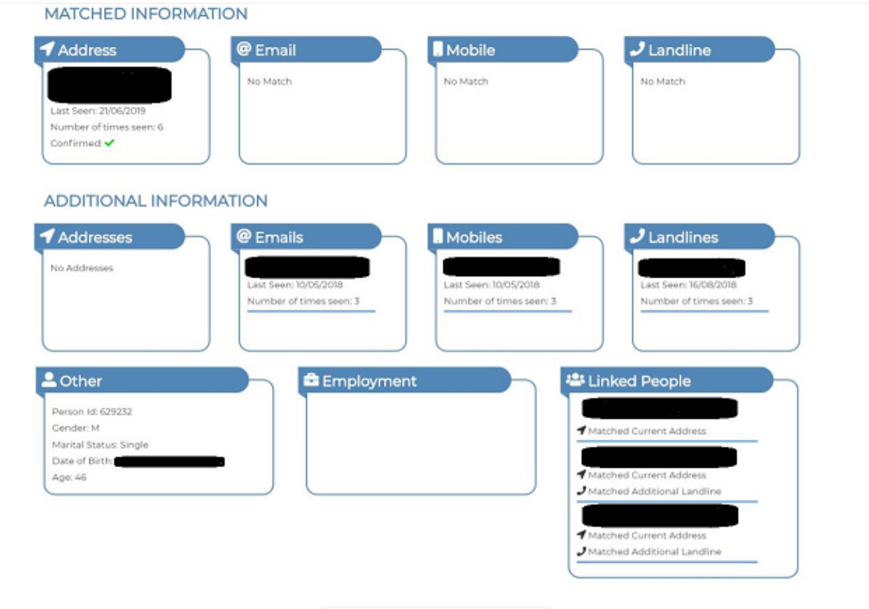


Detailed results page
Validate - Usability testing
Linked people
Notes:
This is our Digital team UX Process Model, and it shows how Design should follow an iterative cycle. These steps would be repeated for each segment or feature of a product to test and validate new functionality throughout the design and build phases.
We start off with the Discover phase, which helps us understand the initial requirements and is the first opportunity for us to validate any assumptions on what our user needs are. We would review existing research that has been performed, or do some desk research or competitor analysis, as well as get familiar with the business requirements.
Next would be the Define phase, which is where the majority of UX assets would be created such as ‘as is’ and ‘to be’ journey mappings, we would start mapping out high level screenflows and taskflow mappings, and towards the latter end of this phase we would start creating the prototype or screen designs.
In the Develop phase we would test and validate the proposed solution, so this could be testing an initial design concept with users to gather feedback, or it could be later on in a project where the built product is being tested and validated before going live.
The Deliver phase is where we present back any research data collected in the validate phase, and would also be where UX roadmap items are prioritised, or analytics and feedback data is reviewed from customer surveys or any other data collected.

Slide 12
Detailed results page
Validate - Usability testing
Improve interaction
Add the information on the page or allow them to click on it and see the list of linked people
They want to see if an address, phone number, email and see if it is shared with someone else
Notes:
This is our Digital team UX Process Model, and it shows how Design should follow an iterative cycle. These steps would be repeated for each segment or feature of a product to test and validate new functionality throughout the design and build phases.
We start off with the Discover phase, which helps us understand the initial requirements and is the first opportunity for us to validate any assumptions on what our user needs are. We would review existing research that has been performed, or do some desk research or competitor analysis, as well as get familiar with the business requirements.
Next would be the Define phase, which is where the majority of UX assets would be created such as ‘as is’ and ‘to be’ journey mappings, we would start mapping out high level screenflows and taskflow mappings, and towards the latter end of this phase we would start creating the prototype or screen designs.
In the Develop phase we would test and validate the proposed solution, so this could be testing an initial design concept with users to gather feedback, or it could be later on in a project where the built product is being tested and validated before going live.
The Deliver phase is where we present back any research data collected in the validate phase, and would also be where UX roadmap items are prioritised, or analytics and feedback data is reviewed from customer surveys or any other data collected.

Slide 13
Detailed results page
Validate - Usability testing
Notes and observations
They copy and paste results into other systems or into “packages” word documents compiling the results of their searches.
Allow users to copy a section of the detailed results in one click to save time for the users and make the app more accessible
All of them suggested exporting the page in pdf format
Notes:
This is our Digital team UX Process Model, and it shows how Design should follow an iterative cycle. These steps would be repeated for each segment or feature of a product to test and validate new functionality throughout the design and build phases.
We start off with the Discover phase, which helps us understand the initial requirements and is the first opportunity for us to validate any assumptions on what our user needs are. We would review existing research that has been performed, or do some desk research or competitor analysis, as well as get familiar with the business requirements.
Next would be the Define phase, which is where the majority of UX assets would be created such as ‘as is’ and ‘to be’ journey mappings, we would start mapping out high level screenflows and taskflow mappings, and towards the latter end of this phase we would start creating the prototype or screen designs.
In the Develop phase we would test and validate the proposed solution, so this could be testing an initial design concept with users to gather feedback, or it could be later on in a project where the built product is being tested and validated before going live.
The Deliver phase is where we present back any research data collected in the validate phase, and would also be where UX roadmap items are prioritised, or analytics and feedback data is reviewed from customer surveys or any other data collected.

